Slide 1
ATP dataset from 2000-03/2018
Source: https://www.kaggle.com/datasets/edouardthomas/atp-matches-dataset
Group: Patrick Schall, Vahid Toomani
The Data source for the Kaggle data set is http://tennis-data.co.uk/

Slide 2
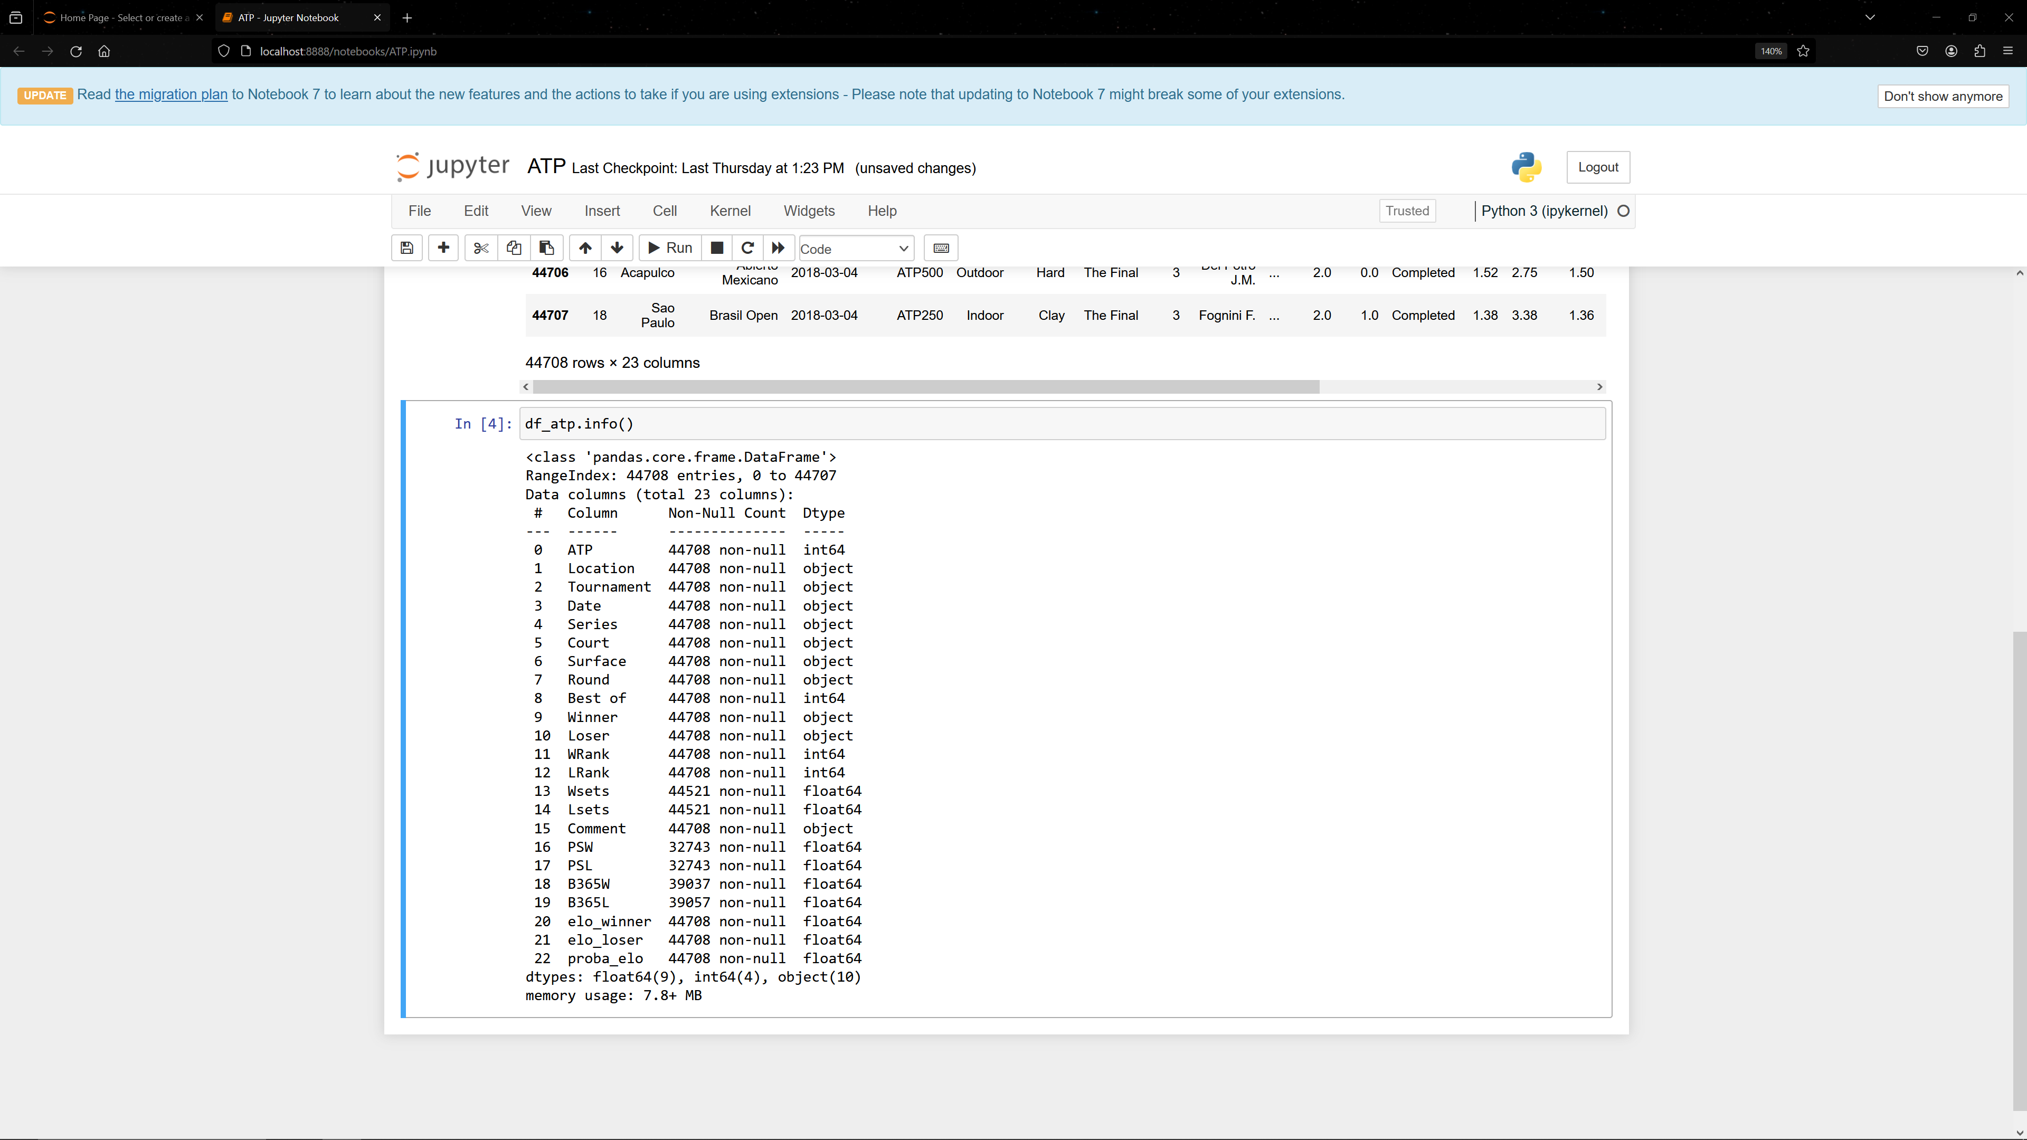
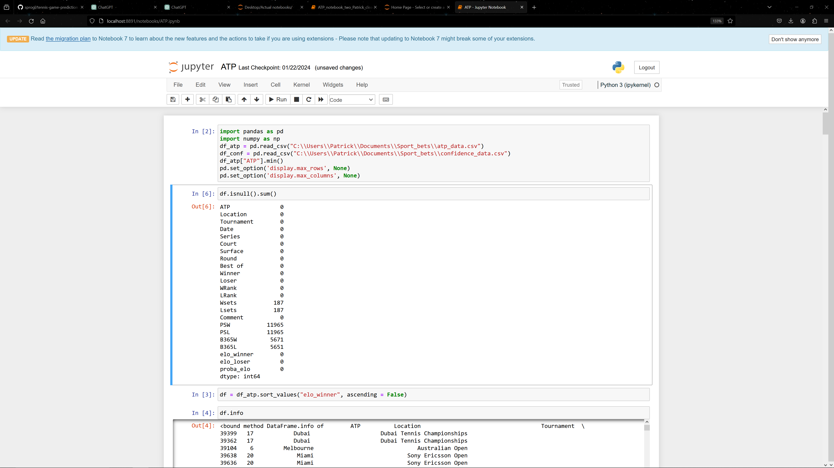
This was our first Data frame with Datapoints form 2000 till 2018
Data frame info
Data missing values

Slide 3
Missing Values
Since we had a data frame with a lot of missing values and only data till 2018 we fetched addionall data until January 2024 from http://tennis-data.co.uk/, which was also the source of the first data set.

Slide 4
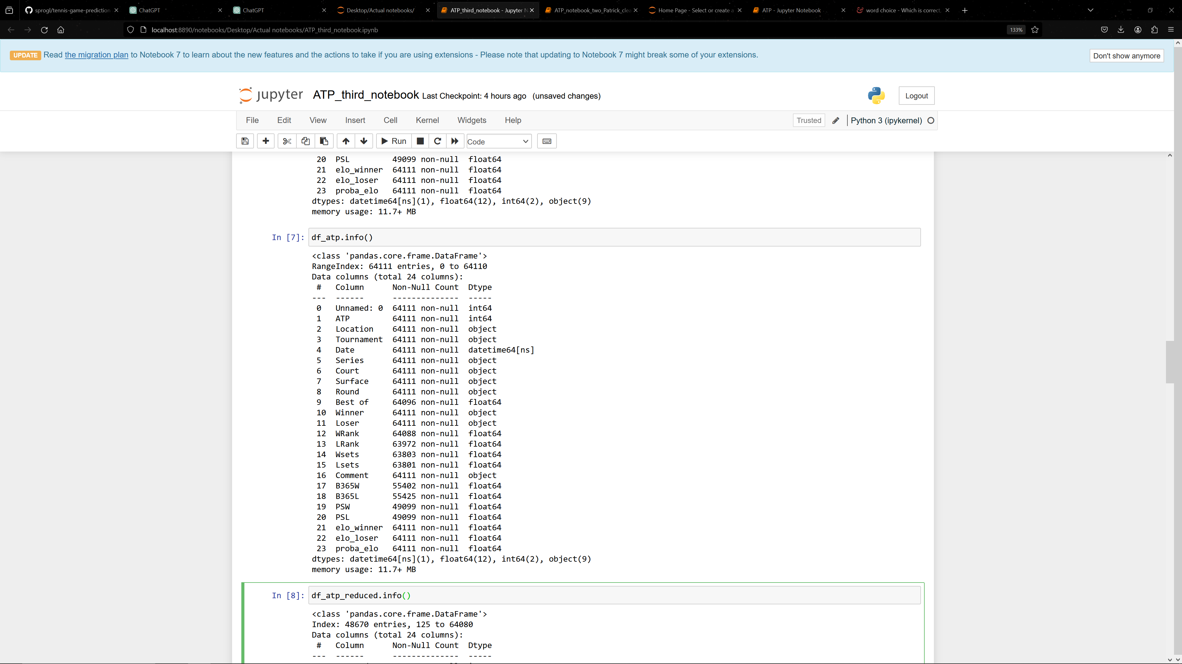
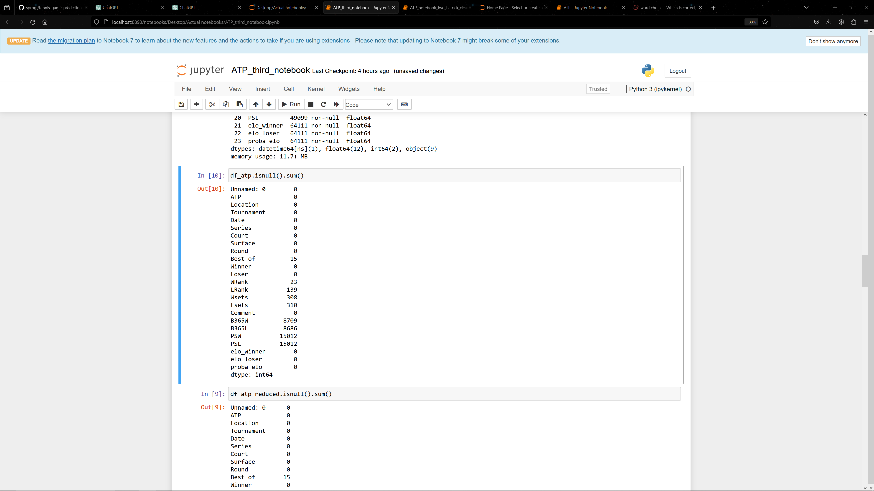
Data set with data from 2000 till 2024
new Data frame 2000-2024
new Data frame 2000-2024 missing values
This dataframe has a lot of missing values and was therefore been cleaned

Slide 5
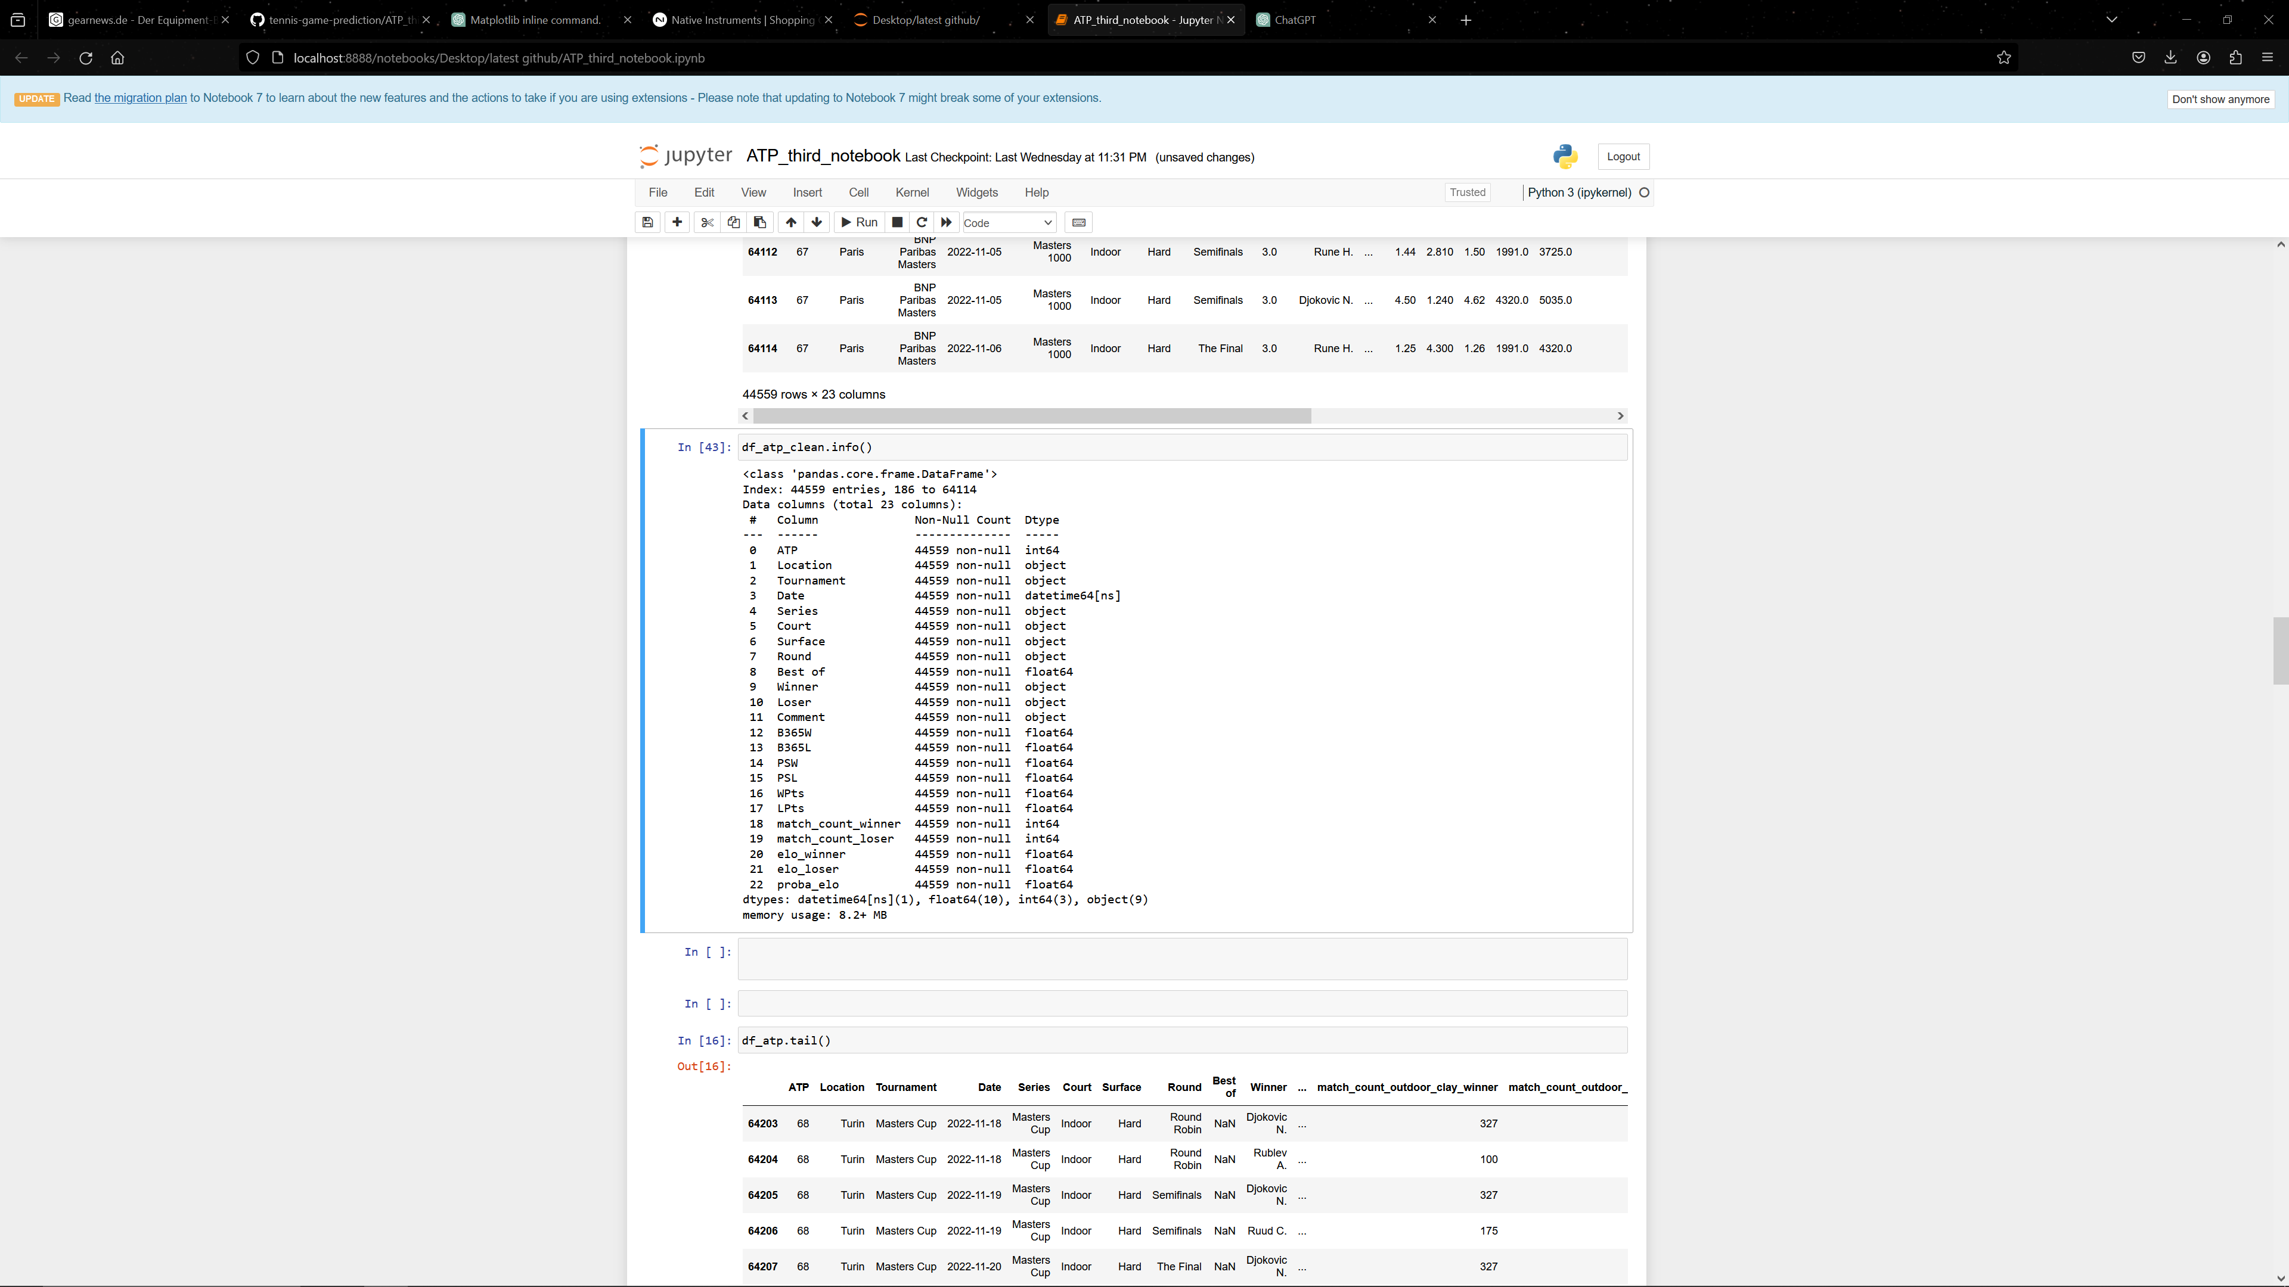
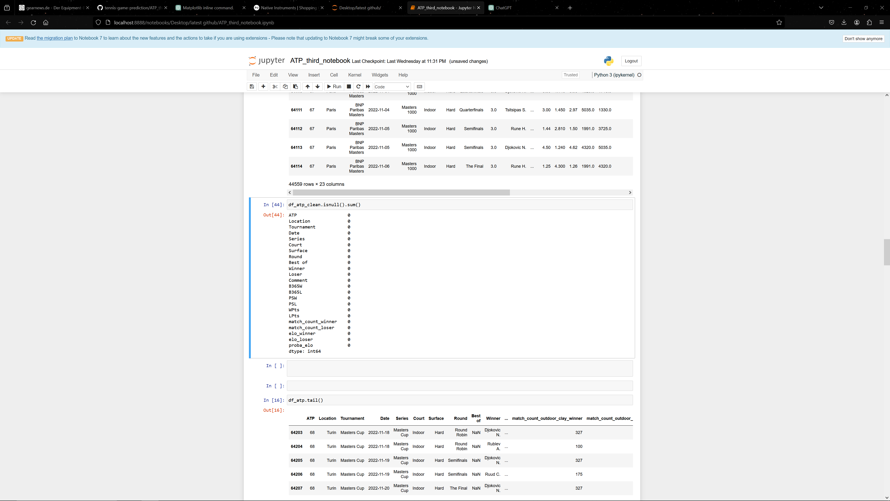
df_atp_clean
This is the final dataframe for the first exploration of the data with datapoint from 2004 till 2024

Slide 6
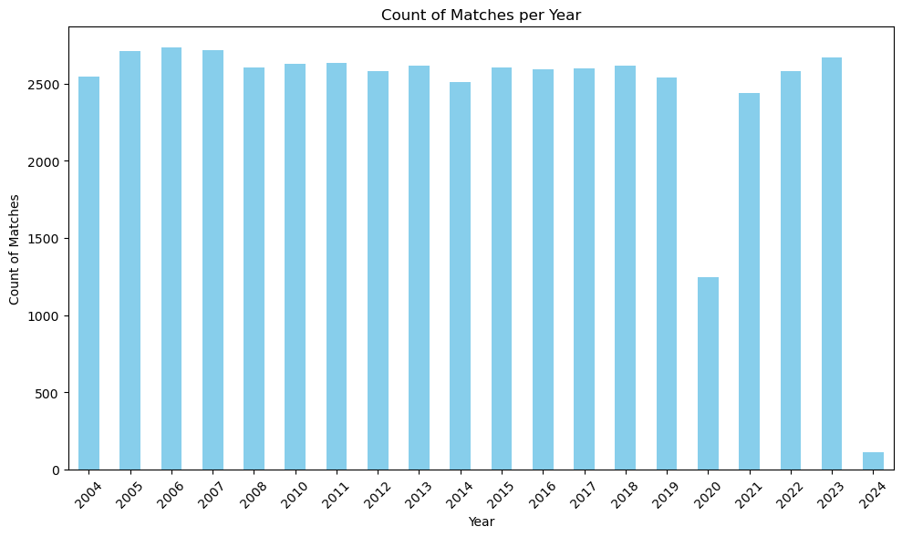
Exploration of the data set
The cleaned data frame has values from 2004 till January 2024!
Number of unique players: 1260

Slide 7
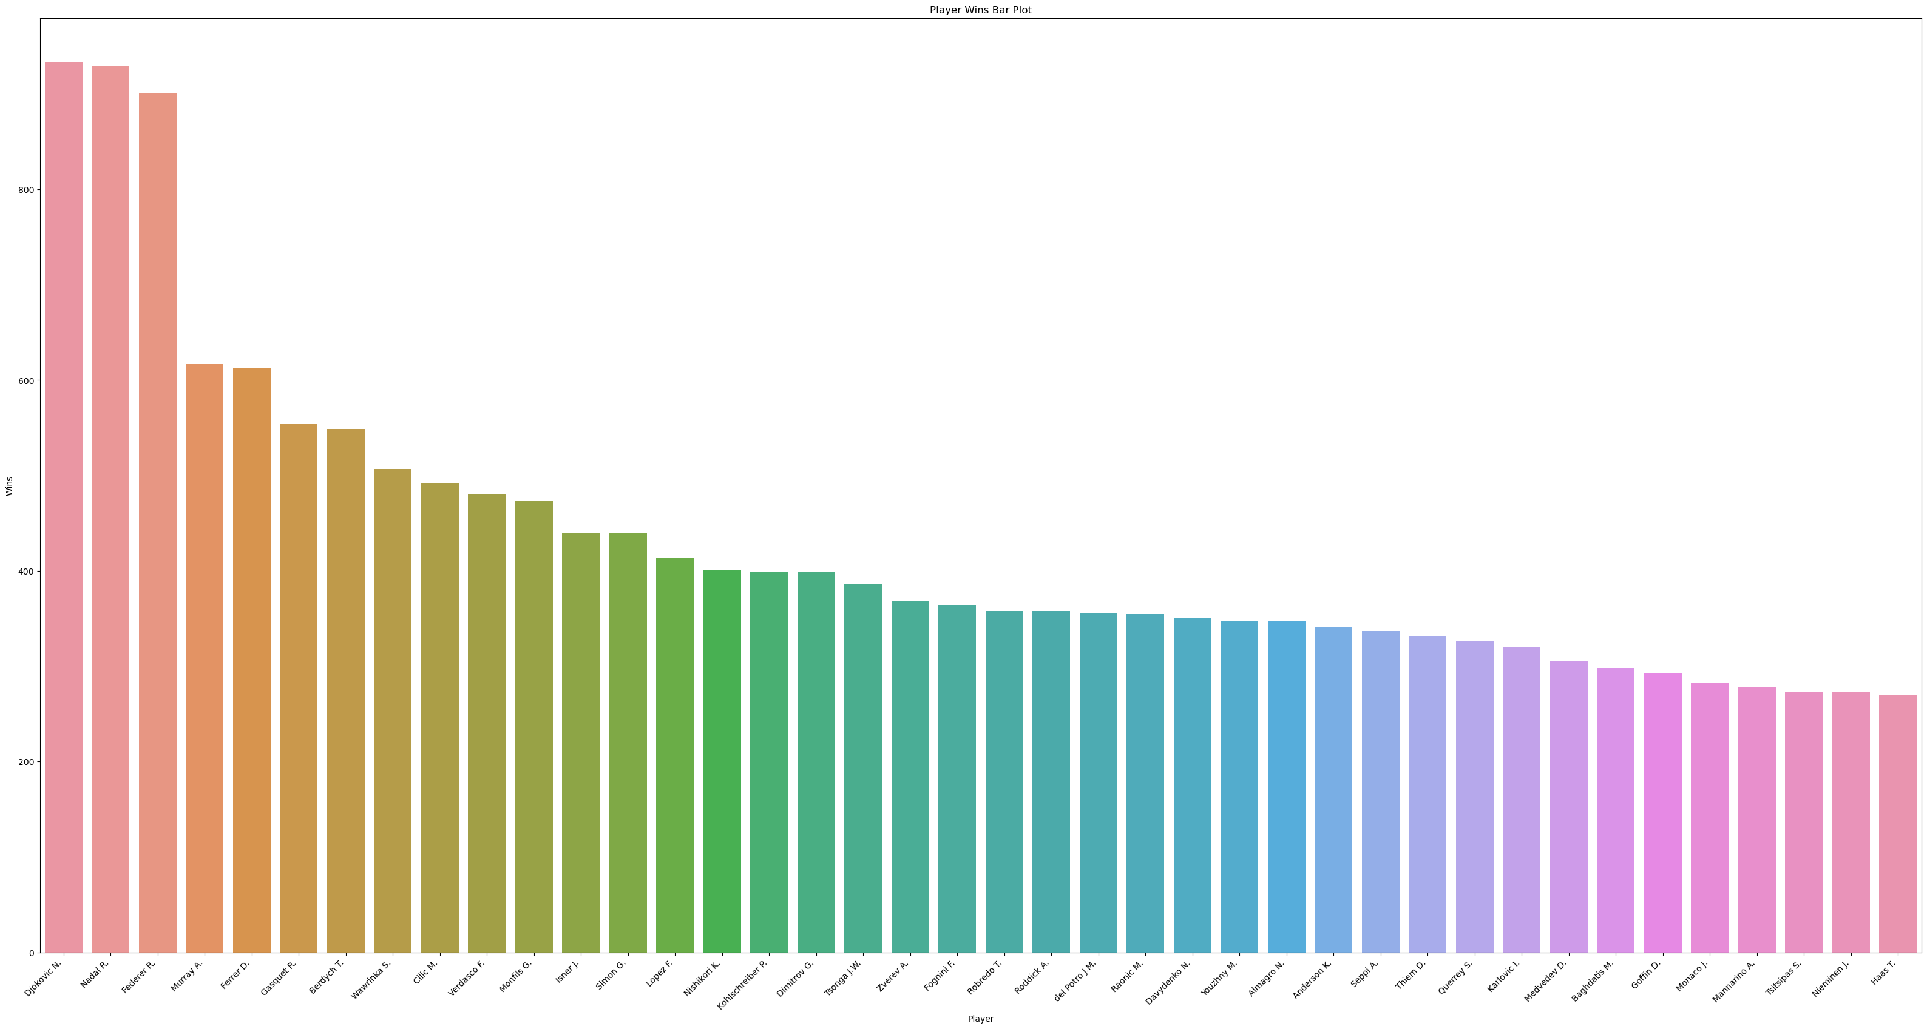
Who has won the most Matches?
Djokovic has won the most tennis matches during that time periode

Slide 8
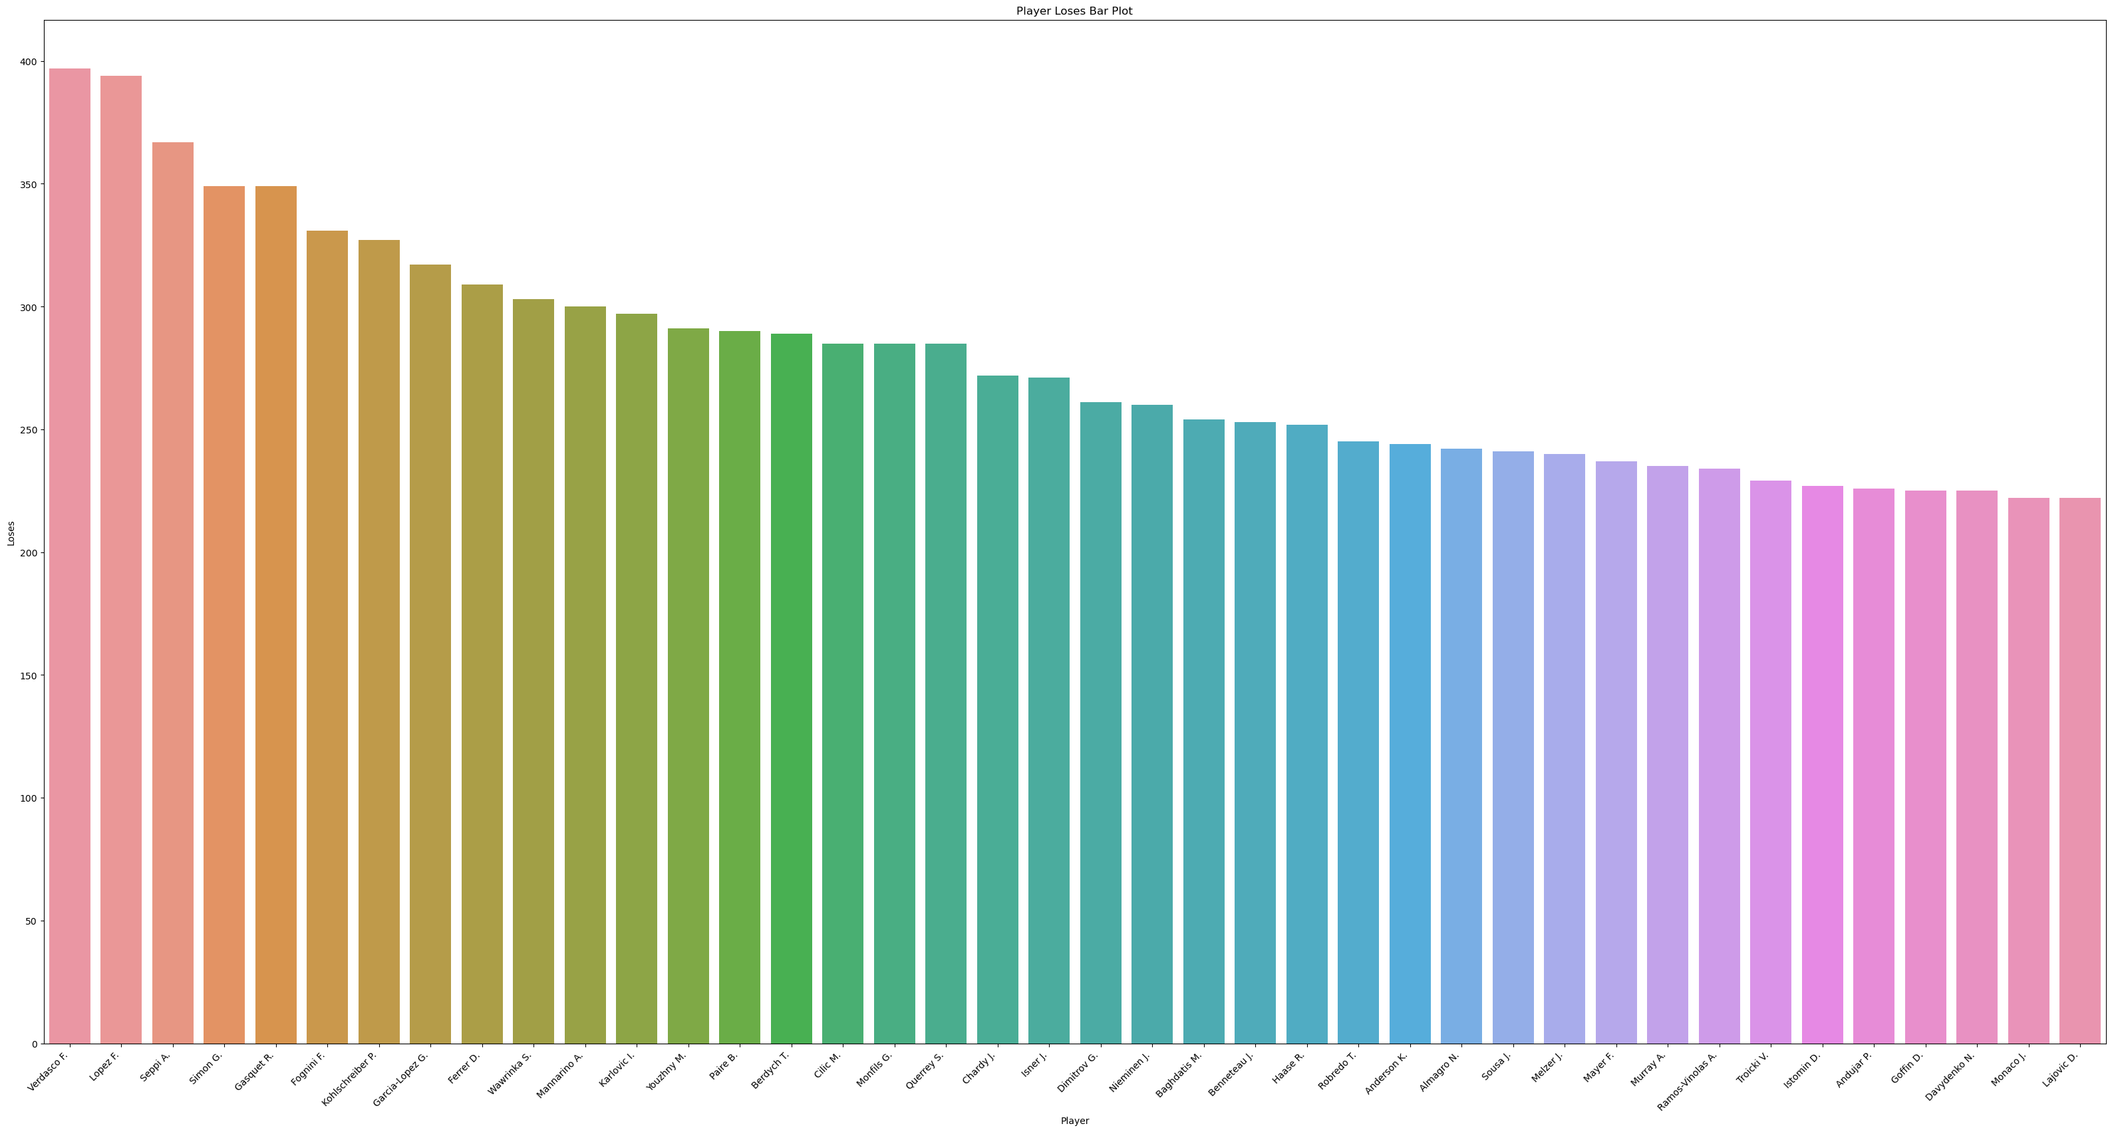
Who has lost the most matches
Verdasco has lost the most tennis matches

Slide 9
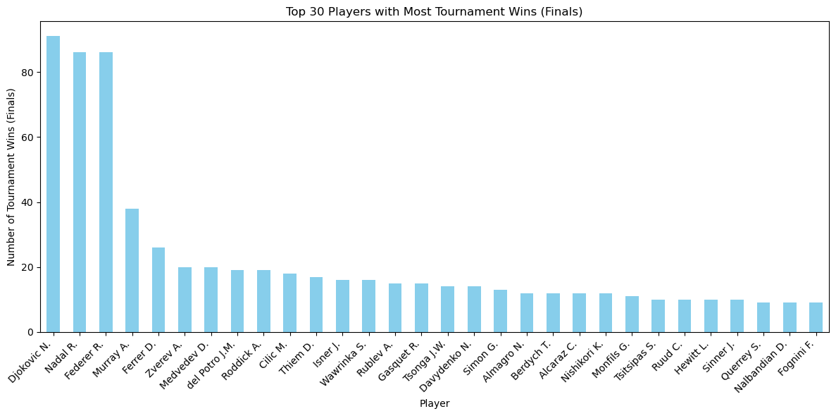
Which player has won the most tournaments

Slide 10
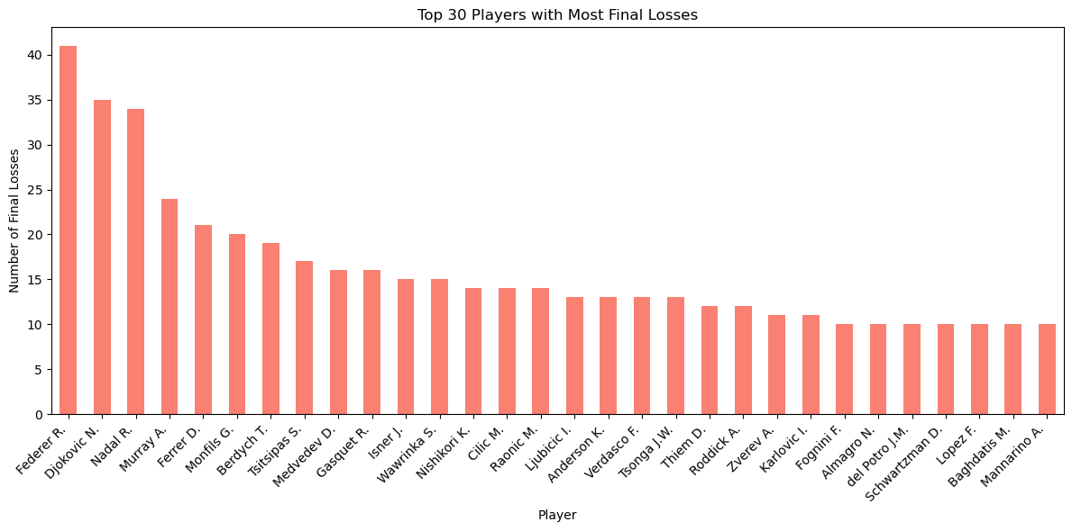
Which player has lost the most finals

Slide 11
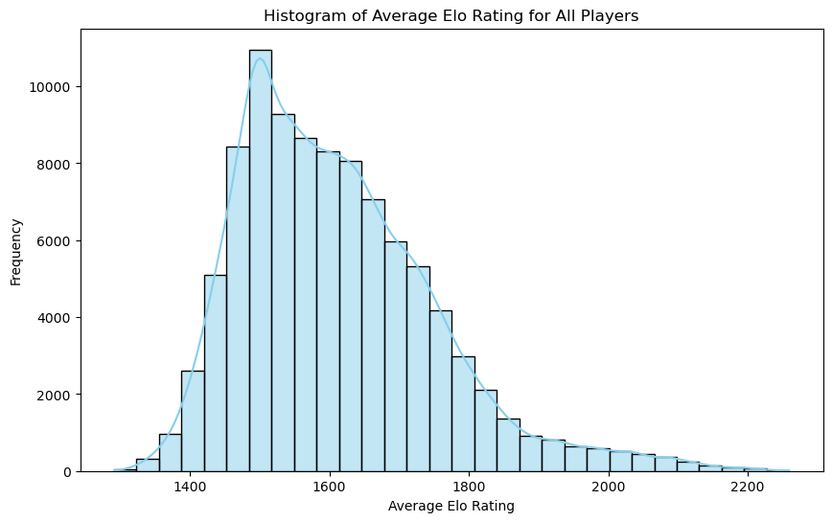
Elo Rating System
Mean of the average Elo ratings of all players: 1611

Slide 12
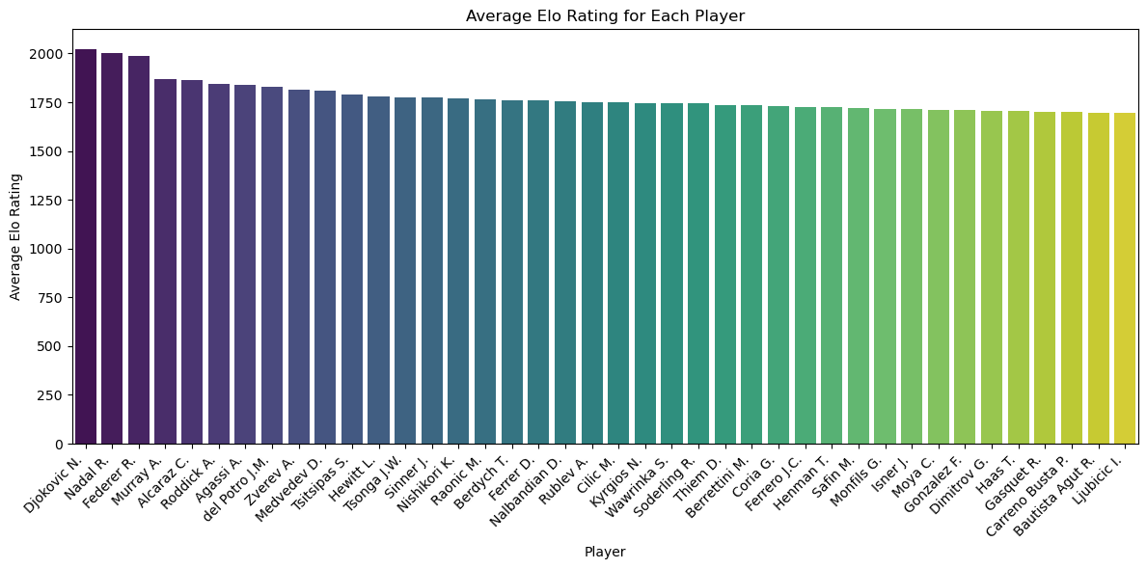
Which player has the best average Elo Rating
The best player on the ATP tour is Djokovic

Slide 13
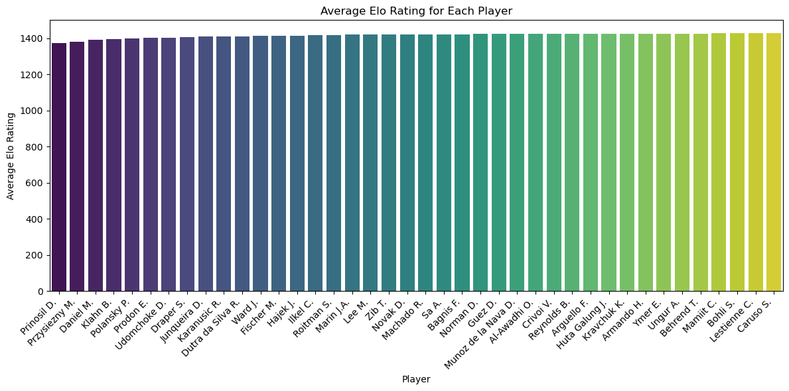
Who has the lowest Elo Rating
Prinosil has the lowest Elo Rating of all players

Slide 14
Which betting house has the better odds?

Slide 15
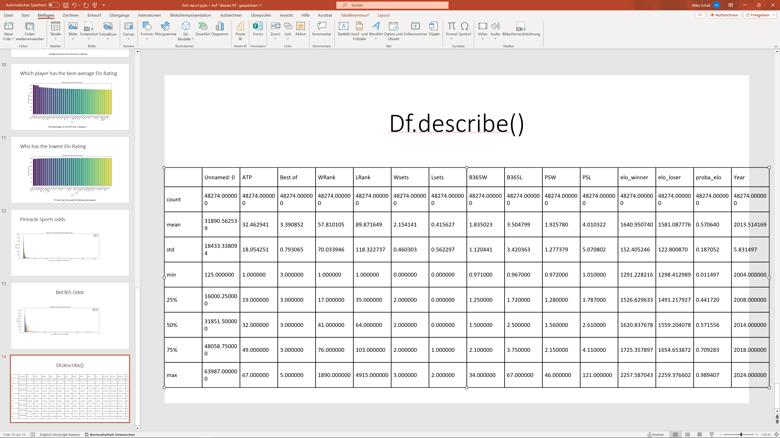
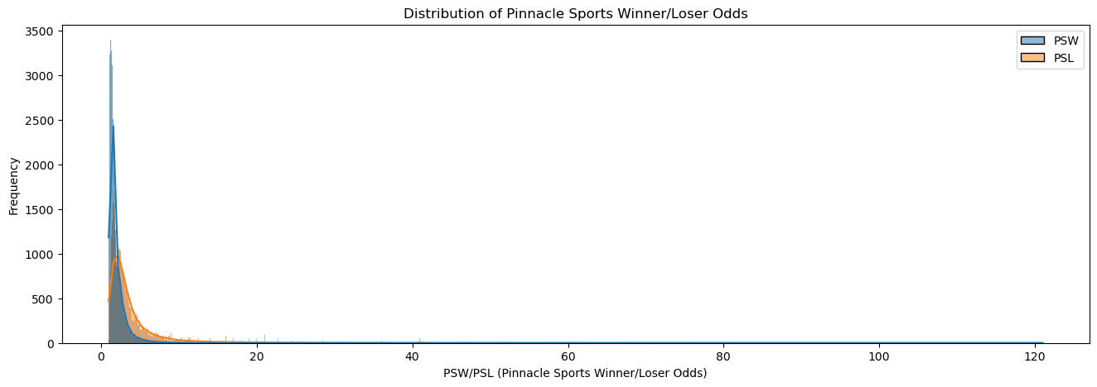
Pinnacle Sports odds

Slide 16
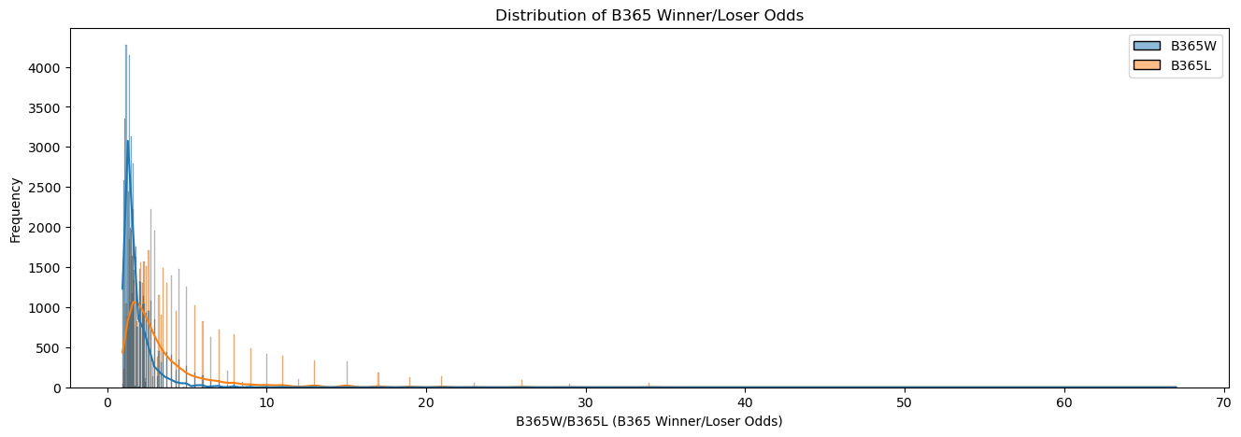
Bet365 Odds

Slide 17
Which betting house has the better odds?
On average the bedder odds has Pinnacle Sports odds

Slide 18
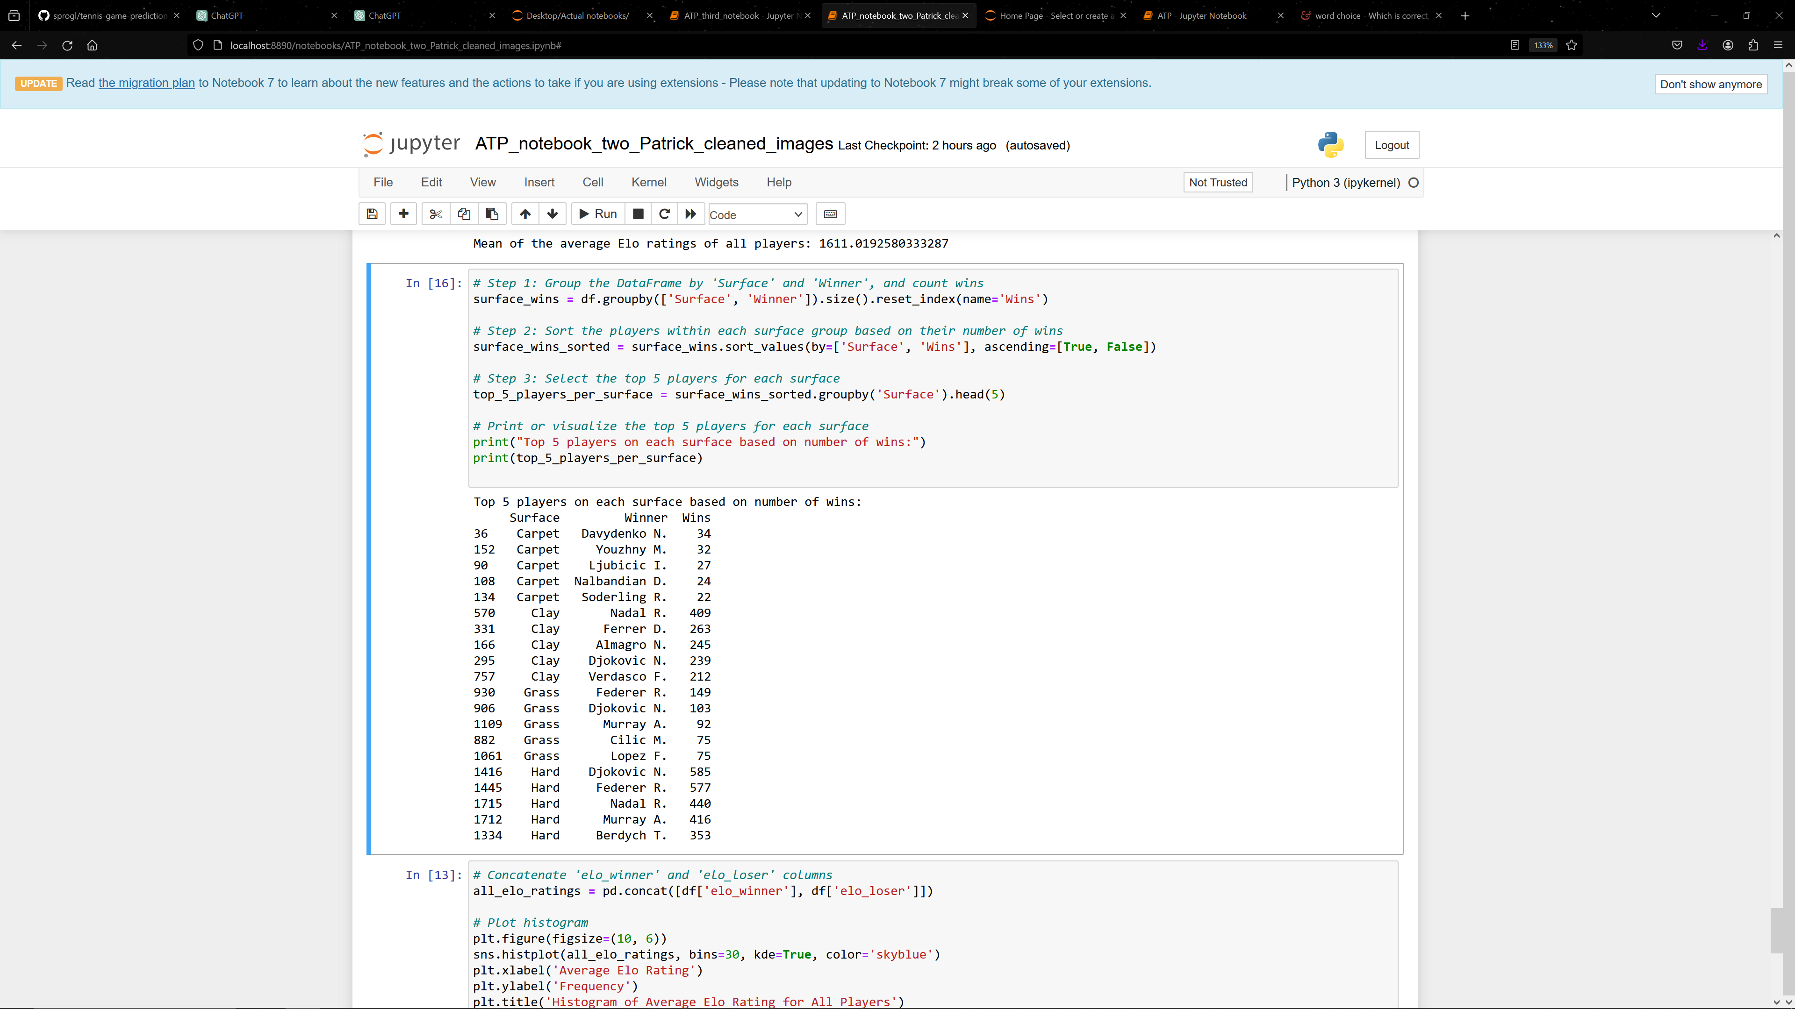
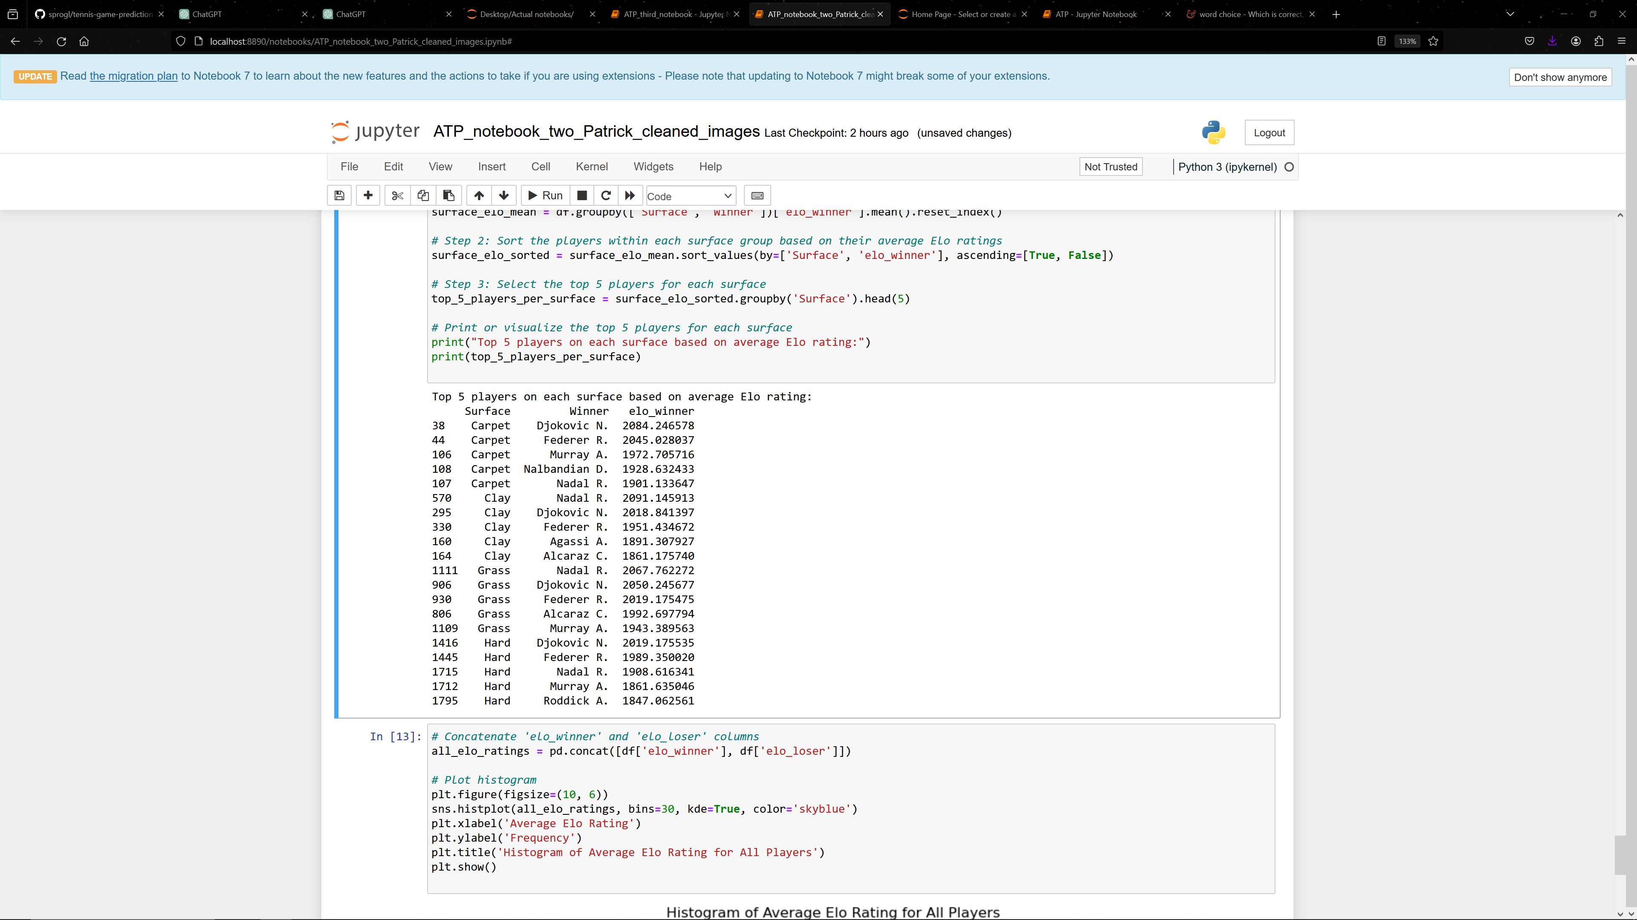
Does the surface matters

Slide 19
Objectives of this research
Predict who is going to win/lose the next game
The goal should be to obtain a model, which gains money – in the final sum - after betting on at least 1000 tennis matches.

Slide 20
Some initial thoughts about the betting strategies
To bet on the higher ranked player (HPBS)
To bet on the lower ranked player (LPBS)
To bet on the player with higher total elo rate (HRBS)
To bet on the player with lower total elo rate (LRBS)
To bet on the player with the better elo rate in the appropirate field type (BRFTBS)
To bet on a random player (RPBS)
To bet on the winner always (WBS)
To bet on the loser always (LBS)
The strategies 7 and 8 are just theoretical and put there to compare the strategies with the theoretical maximum profit/loss.

Slide 21
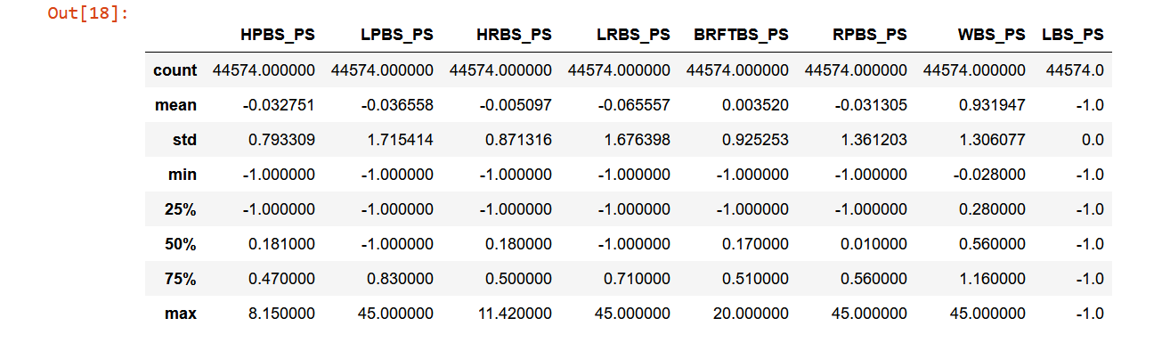
How each strategy would perform on "Pinnacle Sports"
Only strategy the to bet on the player with the better elo rate in the appropirate field type (BRFTBS) would gain some money!

Slide 22
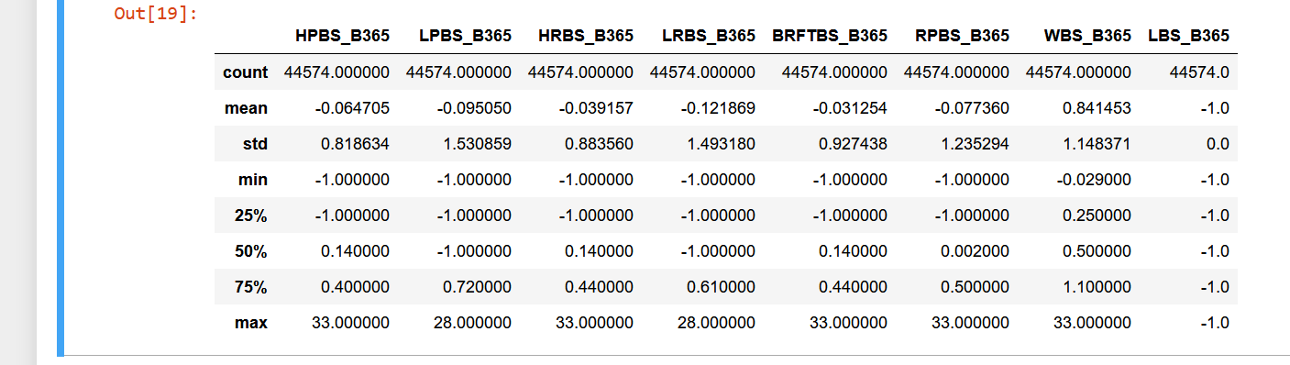
How each strategy would perform on "Bet 365"
No strategy, except of theoretical one to always bet on the winner, would let to an gain of money.

Slide 23
Summary betting strategies
Except of strategy 5 (To bet on the player with the better elo rate in the appropriate field type (BRFTBS)), all betting strategies perform poorly.
This low marginal profit (in case of BRFTBS on PS) can turn up negative by choosing an arbitrary sub set of the matches, which means losing money.
Even in the best case senario, his low margin of profit is increases the risk of losing money.
Therefore, we have to come up with new betting strategies, to gain some money

Slide 24
Machine learning model
To beat bookmakers, we used ML to predict matches as accurate as possible. Algorithms:
Random Forest
Decision tree with Ada boost
Support Vector Machine
Voting algorithm combining above-mentioned algorithms
Neural Network

Slide 25
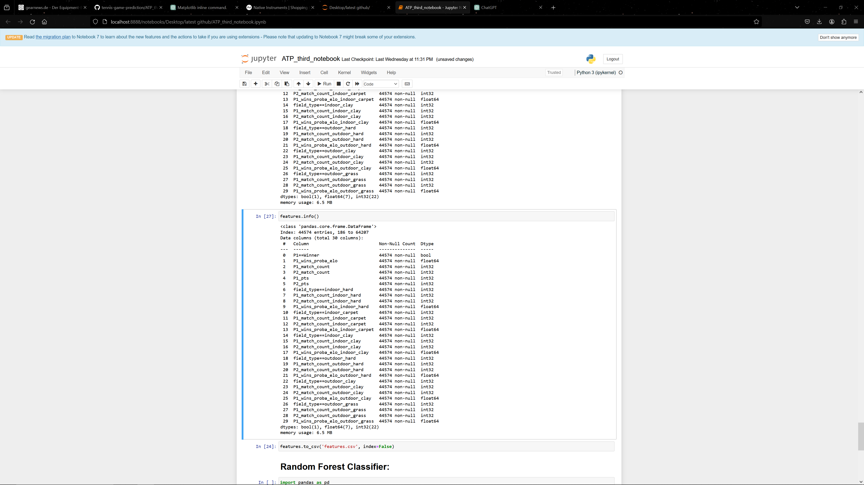
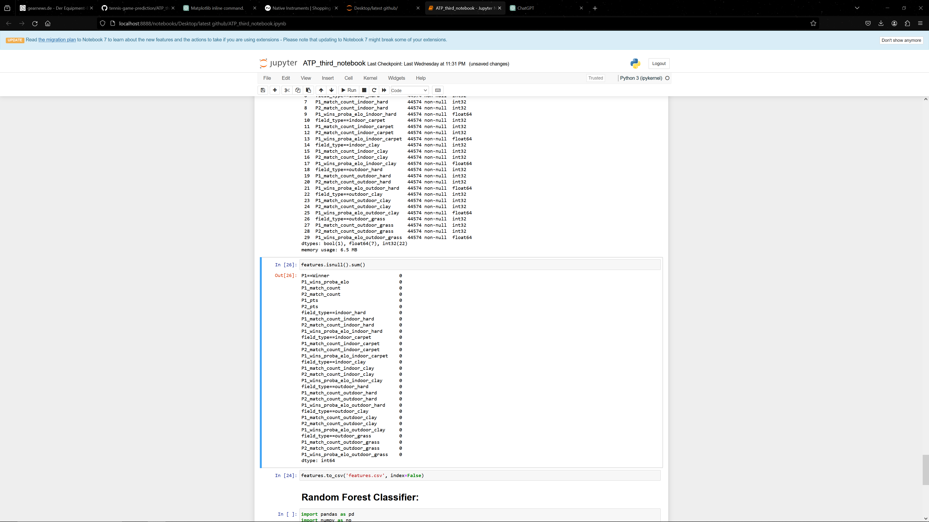
“features” dataframe for modeling
The “feature” Dataframe has been constructed from the df_atp_cleaned dataframe to be used with the different machine learning algorithm

Slide 26
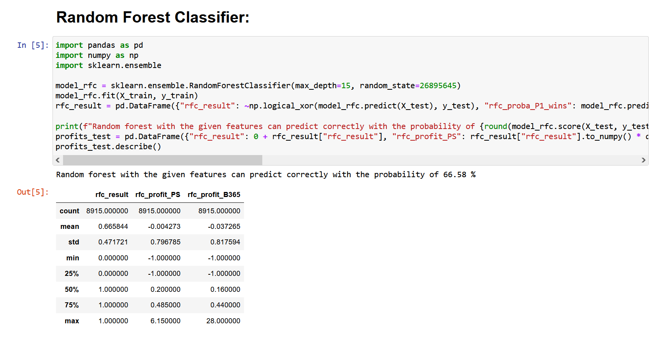
This approach would not lead to any money gain!

Slide 27
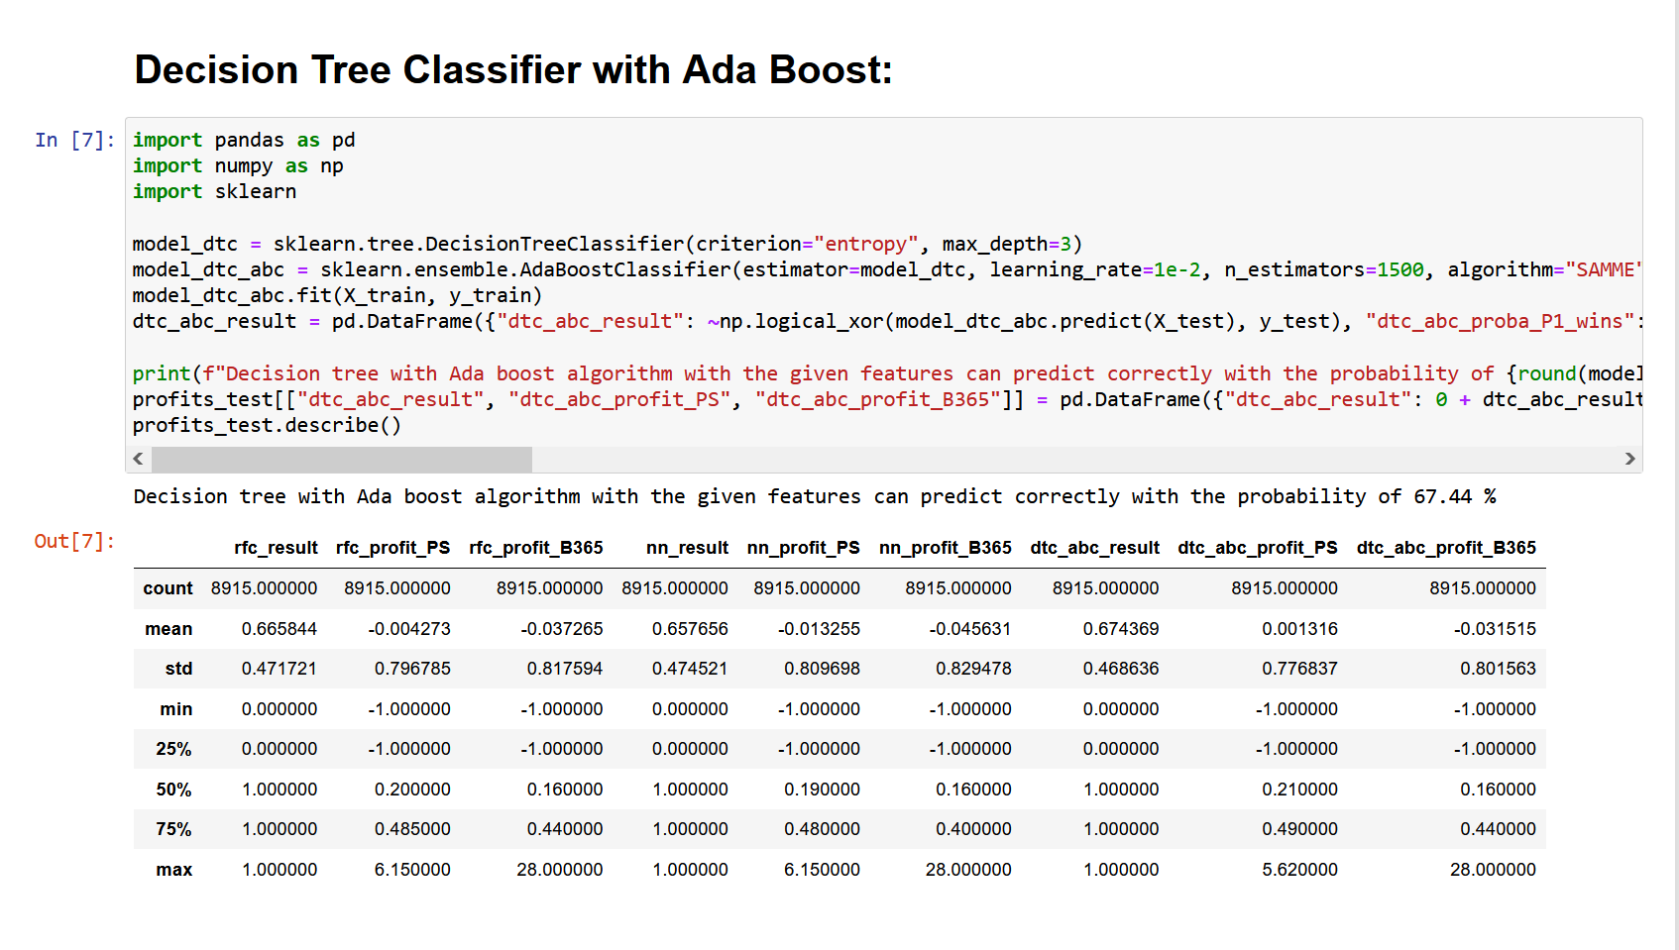
This approach would only lead to a really small profit of 0.0013 $ for each dollar played. So if we would bet 1000 $ we would gain 1.3 $ in profit

Slide 28
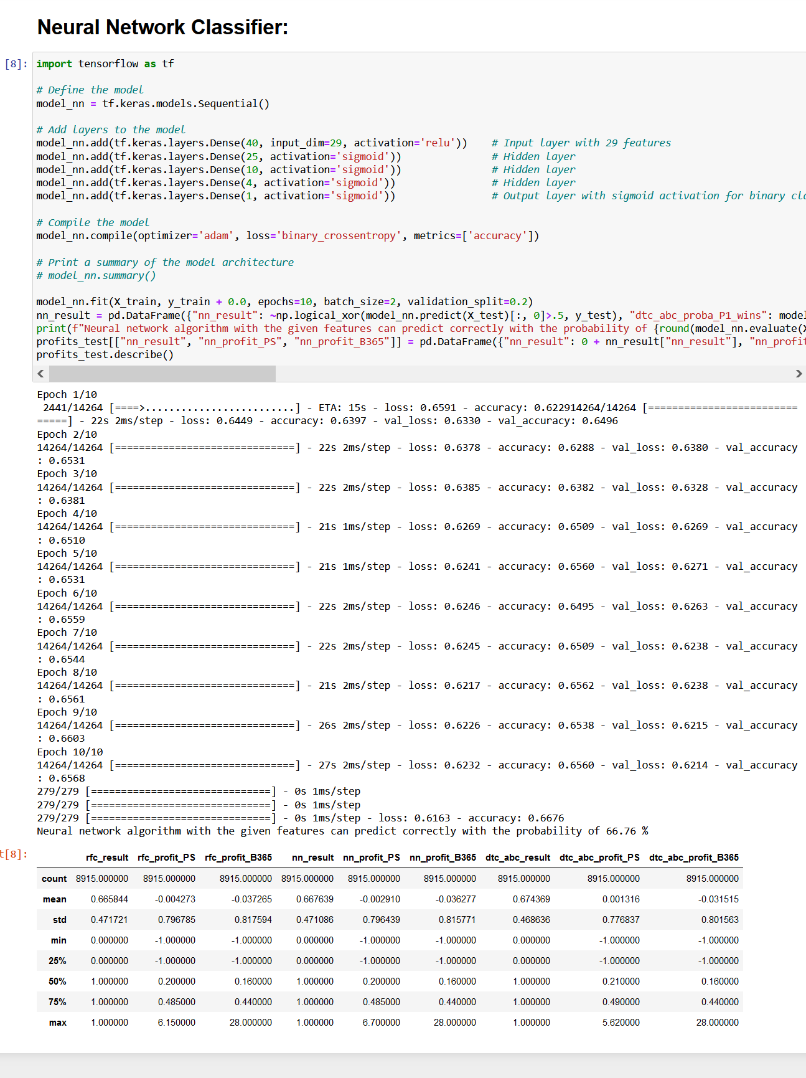
This approach would not lead to any money gain!

Slide 29
Next steps
Proposals:
Not to bet on the games with lower certainties
Bet on matches with different amounts, to lower the over all risk by betting less on the risky matches
Focus on finding players, whose Elo rate is underrepresented (because he is new, or was injured recently)

Slide 30
Summary on first ML models
All three modeling approaches perform poorly.
Only the decision tree could lead in a small profit.
The betting strategy, the feature set and the algorithm must be optimized to increase gain of profit and reduce the probability of losing money.

